Slide 1
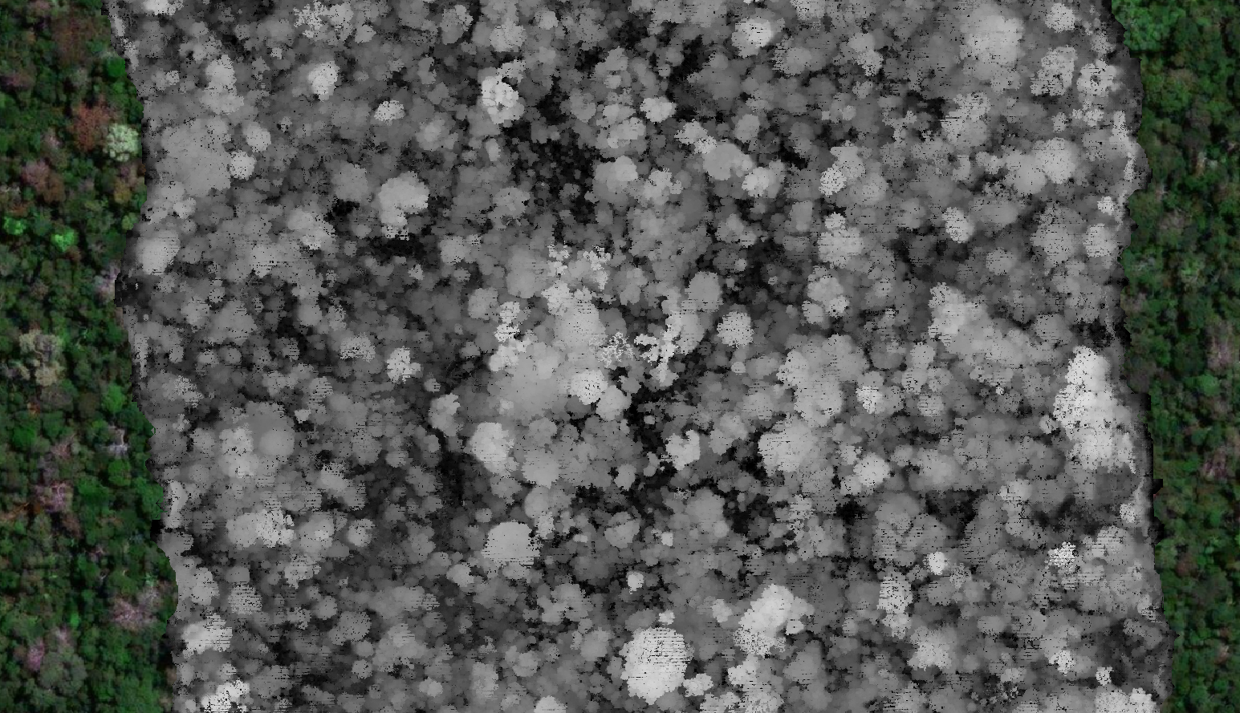


@ WorCAP 2023
MC4 - Introduction to Airborne LiDAR data processing
ricds@hotmail.com
@RicardoDalagnol
Ricardo Dal’Agnol da Silva
UCLA / JPL-NASA / CTrees.org
15 Sep 2023

Slide 2
Short course goal
Give an overview of airborne LiDAR data and processing
What is LiDAR?
Why use LiDAR?
Where to obtain data?
How to use the data?
Processing demonstration with R codes in the repository https://github.com/ricds/lidar_class

Slide 3
Pre-requirements https://github.com/ricds/lidar_class
R, RStudio, download the contents from the GitHub repository and run these lines from the first script “1_lidR_basic_processing.R” to install the packages. It can take a while so run it now : )

Slide 4
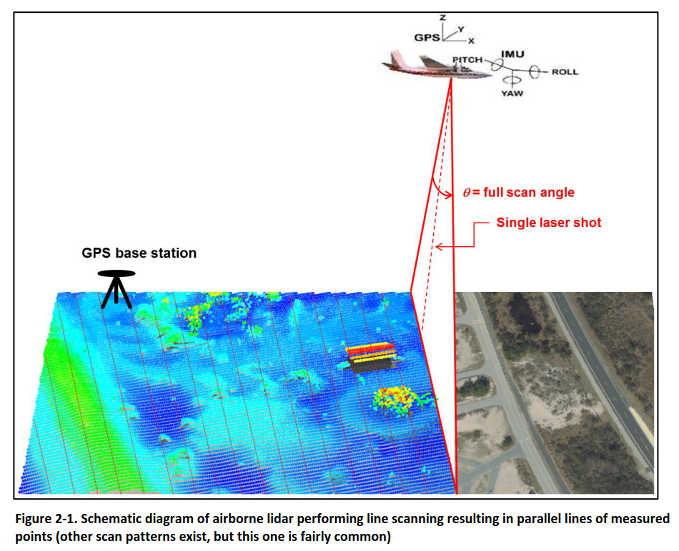
Basics: What is LiDAR?
Light Detection And Ranging
Technology that emits intense, focused beams of light and measures the time it takes for the reflections to be detected by the sensor
Active sensor that allows estimating the height of surface objects
Source: NOAA LiDAR 101. 2012.

Slide 5

What is LiDAR?
Light Detection And Ranging
Technology that emits intense, focused beams of light and measures the time it takes for the reflections to be detected by the sensor
Known Elevation

Slide 6
What is LiDAR?
How much time until the light hit the surface and return?
Light Detection And Ranging
Technology that emits intense, focused beams of light and measures the time it takes for the reflections to be detected by the sensor
Distance = (Speed of Light x Time of Flight) / 2

Slide 7
What is LiDAR?
Light Detection And Ranging
Technology that emits intense, focused beams of light and measures the time it takes for the reflections to be detected by the sensor
Known Elevation
Known Elevation

Slide 8
What is LiDAR?
Light Detection And Ranging
Technology that emits intense, focused beams of light and measures the time it takes for the reflections to be detected by the sensor
height

Slide 9
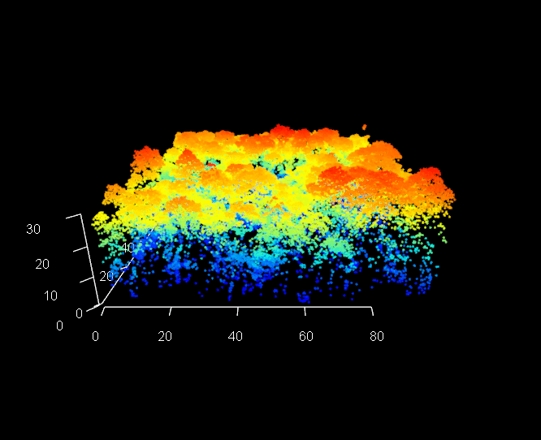
The Point Cloud

Slide 10
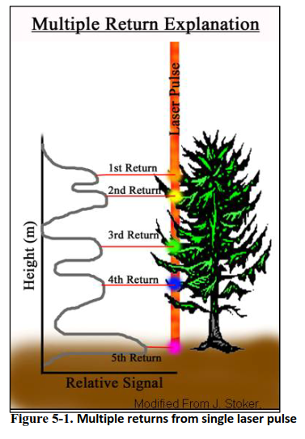
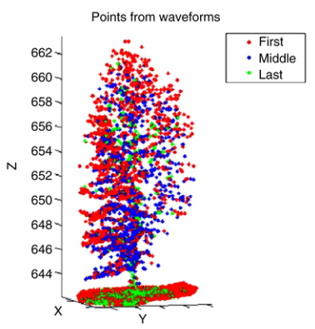
Lidar multiple returns and interaction with objects
Source: NOAA LiDAR 101. 2012.
Clément Mallet, Frédéric Bretar. (2009). Full-waveform topographic lidar: State-of-the-art. ISPRS Journal.

Slide 11
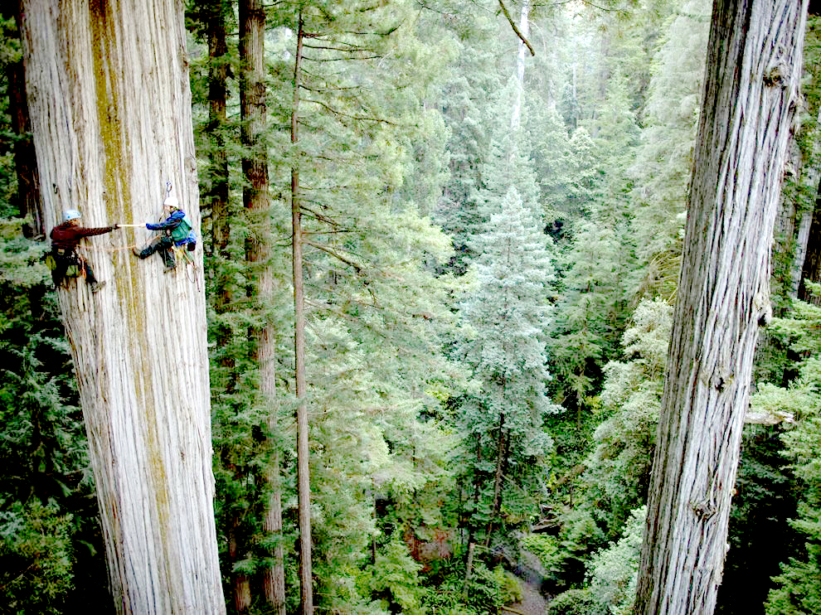
Applications: Why use LiDAR ?
Source: National Geographic / NEON - https://www.neonscience.org/lidar-basics

Slide 12
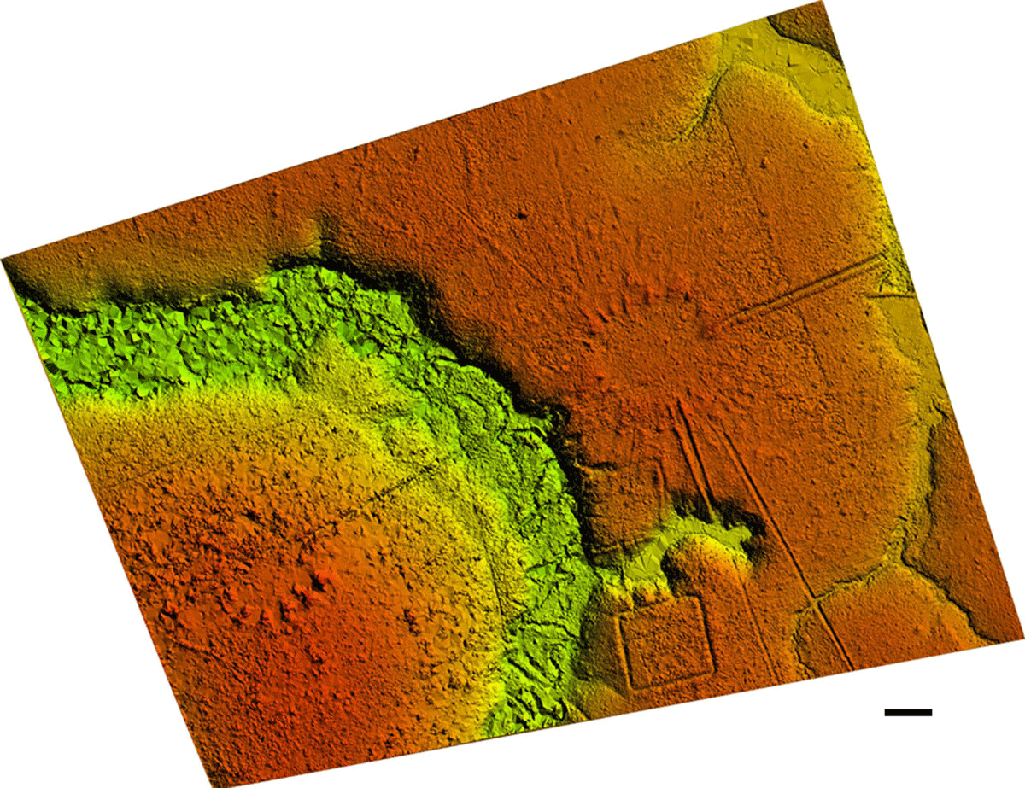
Archeology - Geoglyphs
Finding evidences of human colonization under the forest canopy using airborne LiDAR DTM
Iriarte, J., Robinson, M., de Souza, J., Damasceno, A., da Silva, F., Nakahara, F., Ranzi, A. and Aragao, L., 2020. Geometry by Design: Contribution of Lidar to the Understanding of Settlement Patterns of the Mound Villages in SW Amazonia. Journal of Computer Applications in Archaeology, 3(1), pp.151–169. DOI: http://doi.org/10.5334/jcaa.45
50 m

Slide 13
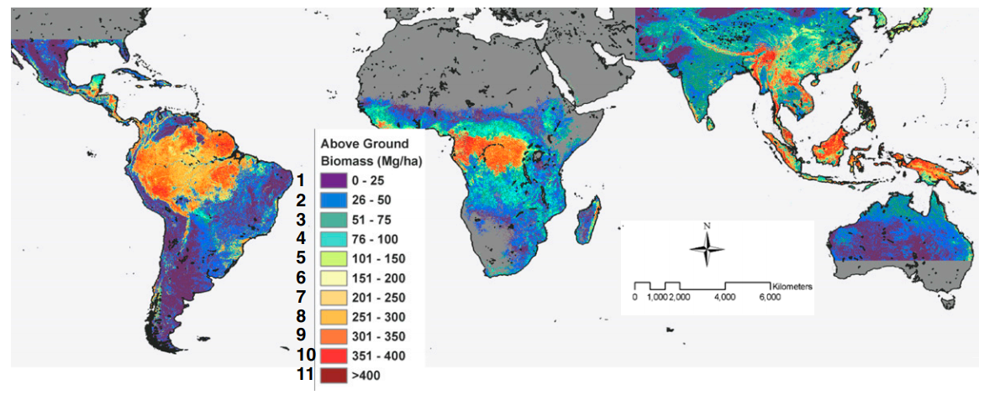
1-km Biomass estimates aided by orbital LiDAR
Saatchi et al. (2011). Benchmark map of forest carbon stocks in tropical regions across three continents. PNAS.

Slide 14
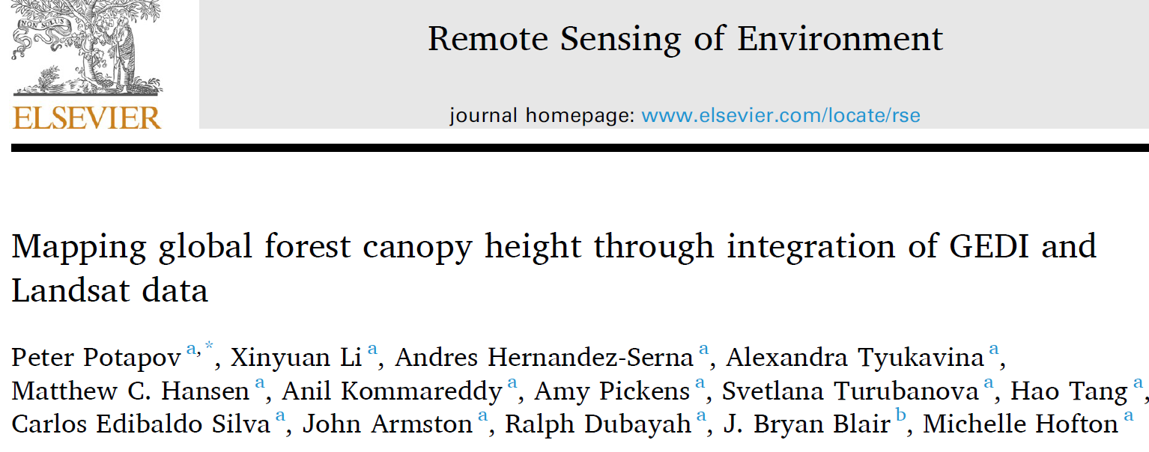
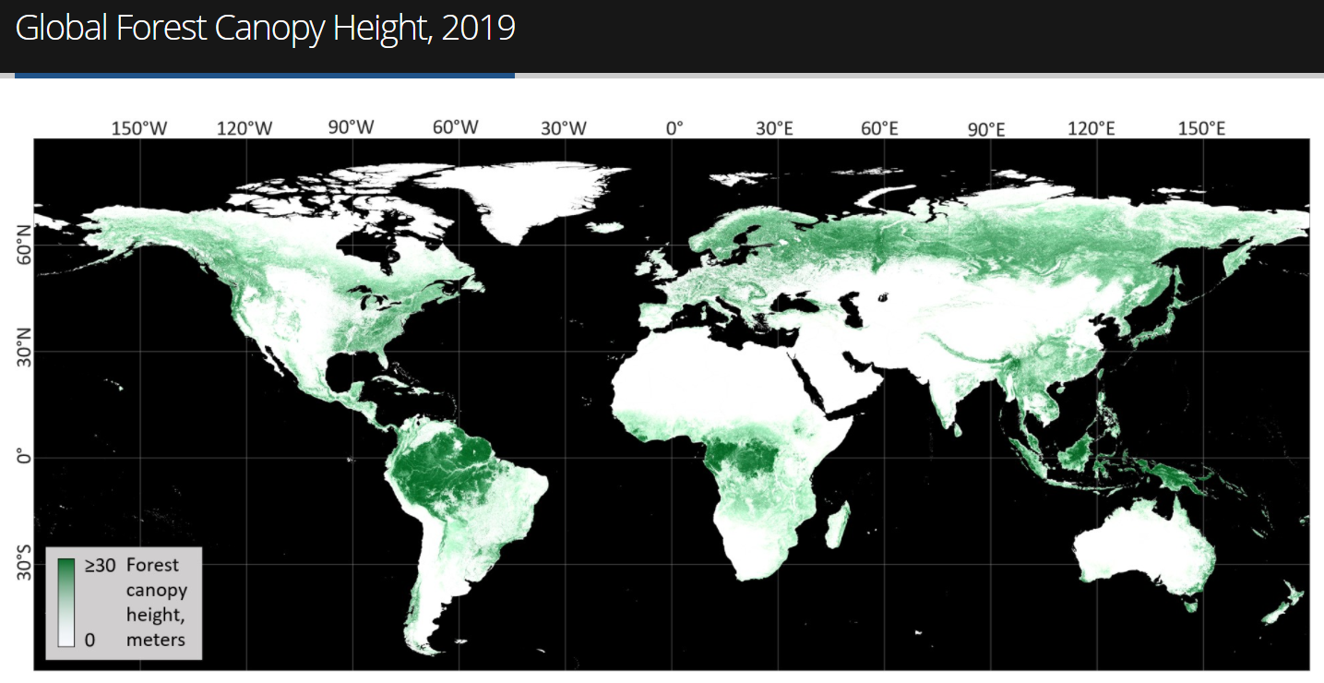
30-m spatial resolution global forest canopy height map was developed through the integration of the Global Ecosystem Dynamics Investigation (GEDI) lidar forest structure measurements and Landsat analysis-ready data time-series.

Slide 15
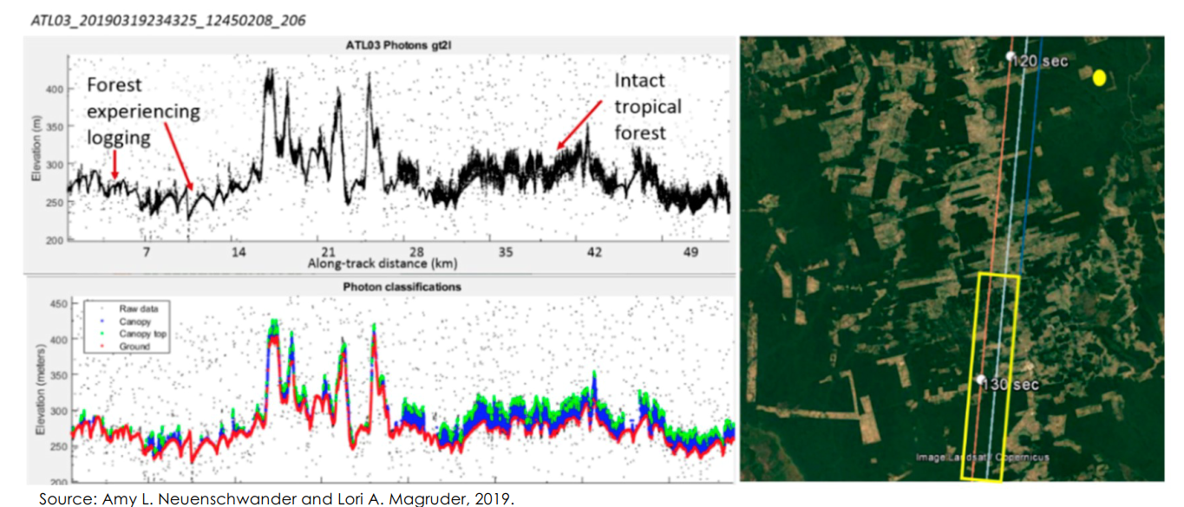
Orbital lidar IceSat-2 – transect example

Slide 16
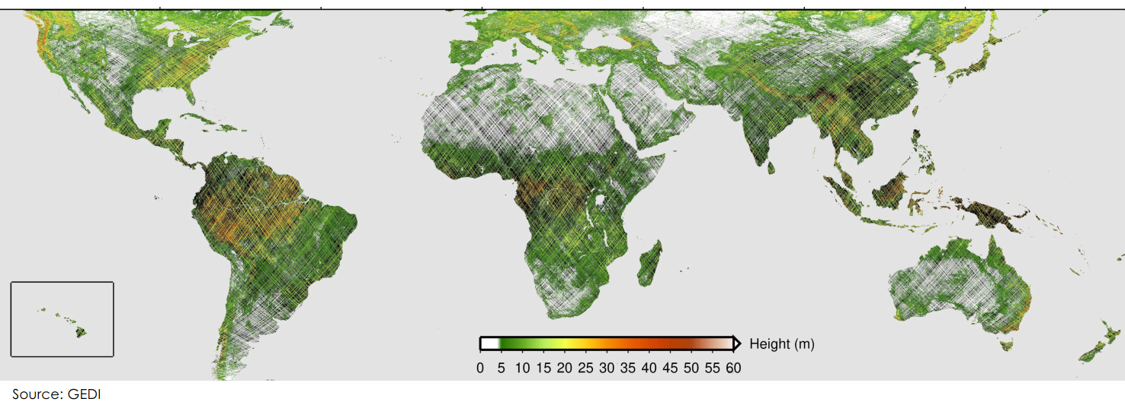
GEDI - Global vegetation height

Slide 17
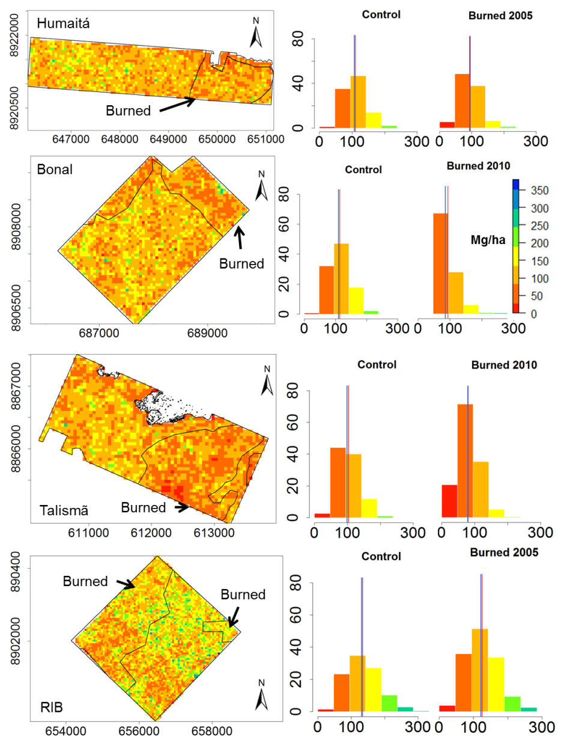
Fire impacts on biomass
“Even ten years after the ﬁre event, there was no complete recovery of the height and biomass of the burned areas” (Sato et al. 2016)
Sato, L.Y.; Gomes, V.C.F.; Shimabukuro, Y.E.; Keller, M.; Arai, E.; Dos-Santos, M.N.; Brown, I.F.; Aragão, L.E.O.C. Post-Fire Changes in Forest Biomass Retrieved by Airborne LiDAR in Amazonia. Remote Sens. 2016, 8, 839.

Slide 18
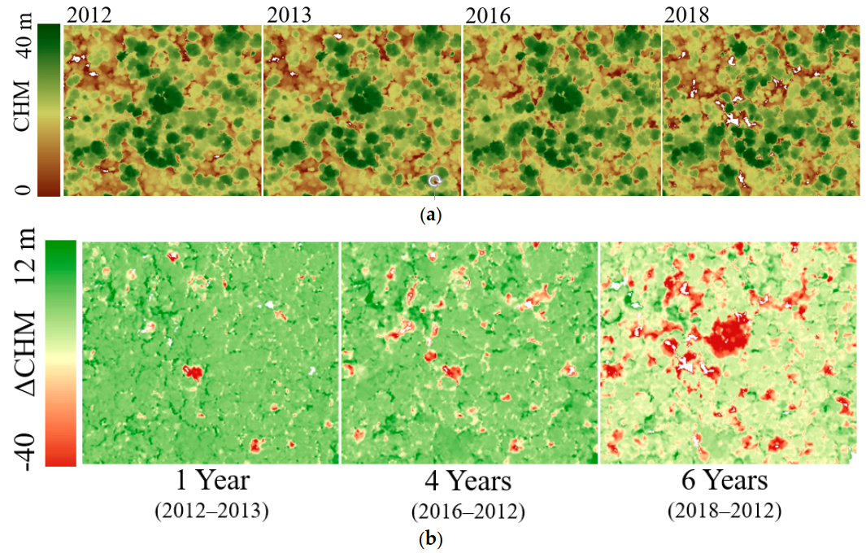
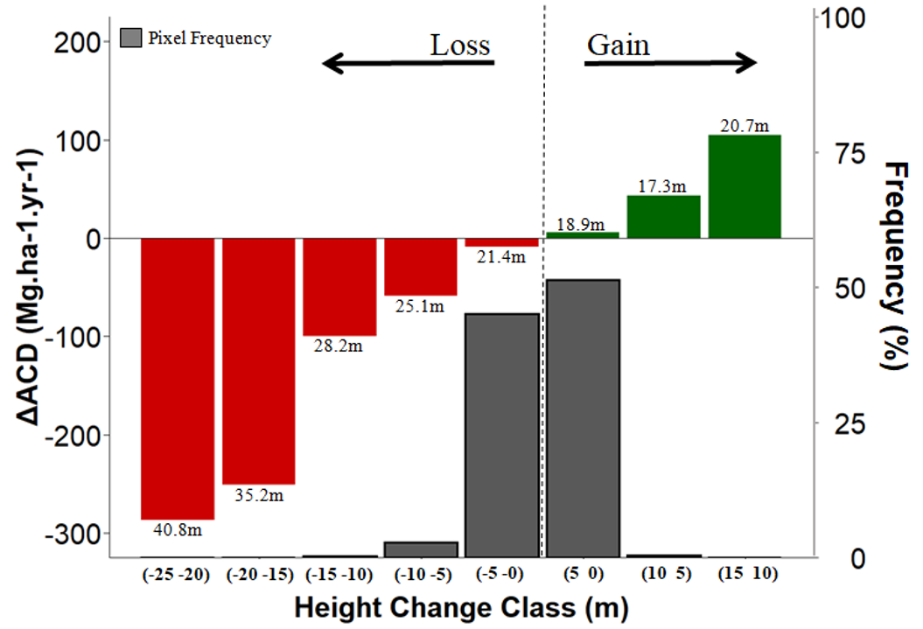
Human modified forests: carbon source or sinks? Application of multi-temporal LiDAR
Moura, Y.M.; Balzter, H.; Galvão, L.S.; Dalagnol, R.; Espírito-Santo, F.; Santos, E.G.; Garcia, M.; Bispo, P.C.; Oliveira, R.C.; Shimabukuro, Y.E. Carbon Dynamics in a Human-Modified Tropical Forest: A Case Study Using Multi-Temporal LiDAR Data. Remote Sens. 2020, 12, 430.

Slide 19
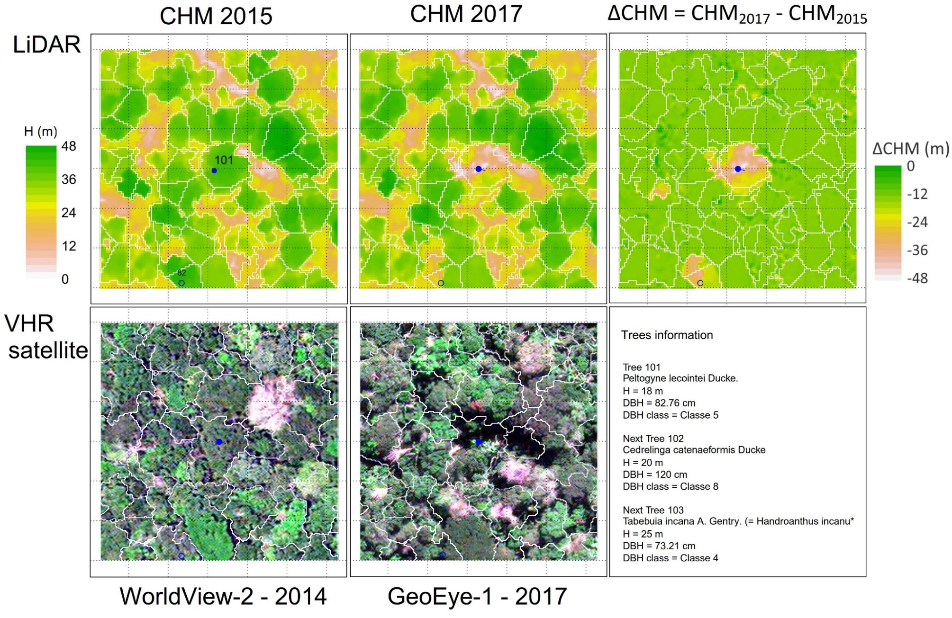
Detecting individual tree loss from selective logging
Logged tree
Dalagnol, R.; Phillips, O.L.; Gloor, E.; Galvão, L.S.; Wagner, F.H.; Locks, C.J.; Aragão, L.E.O.C. Quantifying Canopy Tree Loss and Gap Recovery in Tropical Forests under Low-Intensity Logging Using VHR Satellite Imagery and Airborne LiDAR. Remote Sens. 2019, 11, 817.

Slide 20
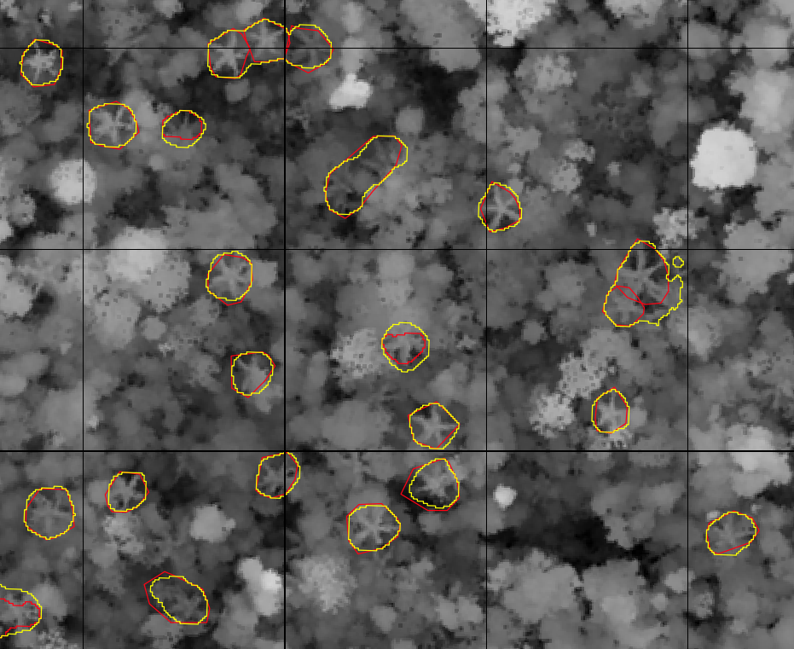
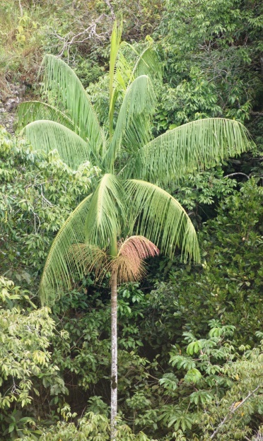
Spatial & temporal distribution of plant species
Canopy palm trees detection using airborne LiDAR data and deep learning (Dalagnol et al., 2022)
Red = manual
Yellow = automatic
50 meters

Slide 21
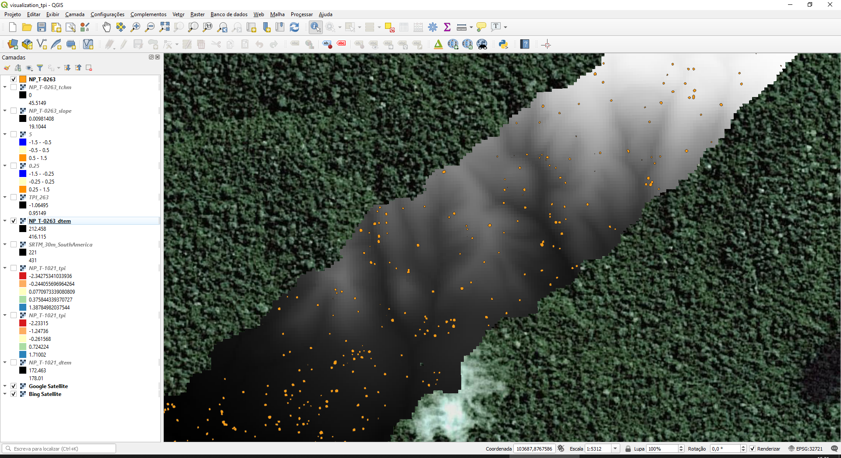
DTM – Microtopography

Slide 22
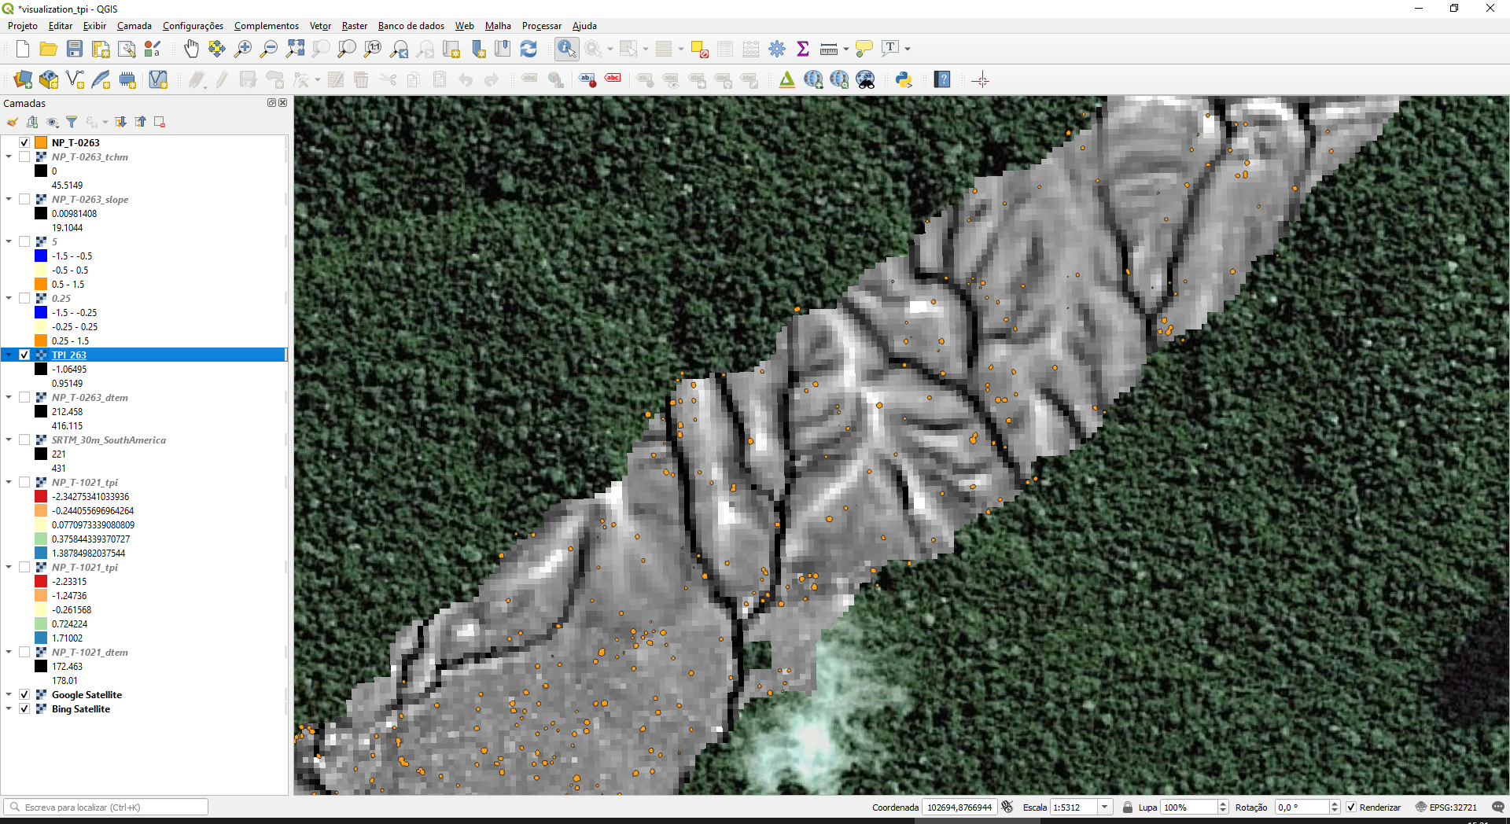
TPI – Topographic Position Index (normalized by mean elevation)
De Reu, J., J. Bourgeois, M. Bats, A. Zwertvaegher, V. Gelorini, et al., (2014) Application of the topographic position index to heterogeneous landscapes. Geomorphology, 186:39-49.

Slide 23
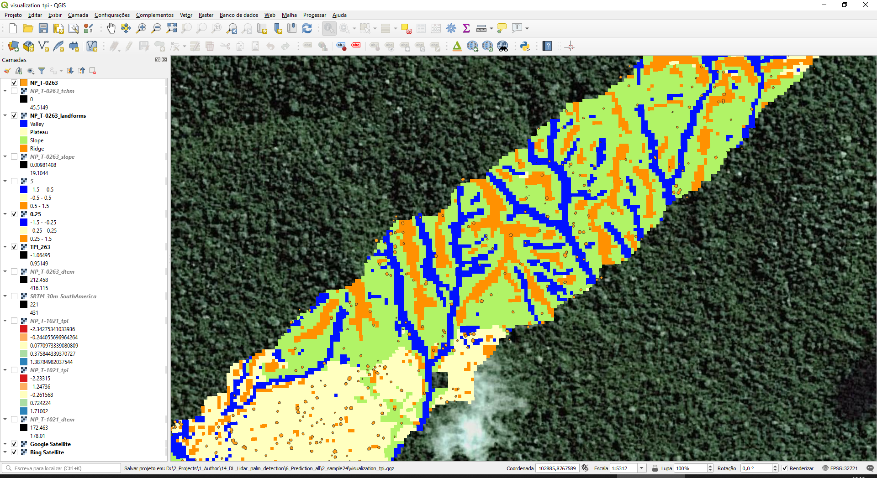
Landforms (TPI + Slope)
Extra info here (quite beautiful images): http://www.jennessent.com/downloads/tpi-poster-tnc_18x22.pdf

Slide 24
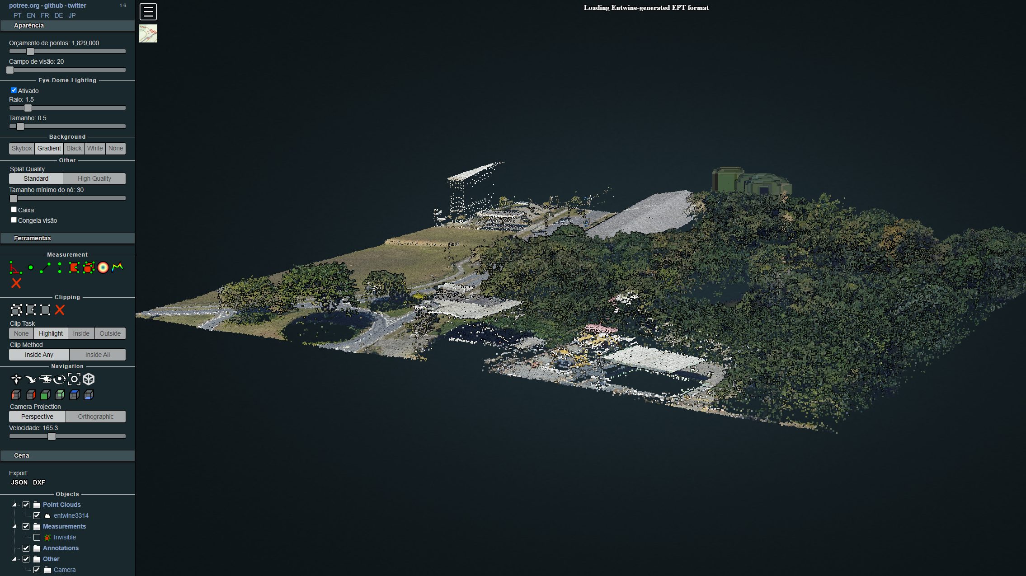
Sao Paulo City – fully covered by lidar in 2017
Follow these links to access:
https://spamlab.github.io/blog/pmsp_lidar_aws/
https://geosampa.prefeitura.sp.gov.br/PaginasPublicas/_SBC.aspx

Slide 25
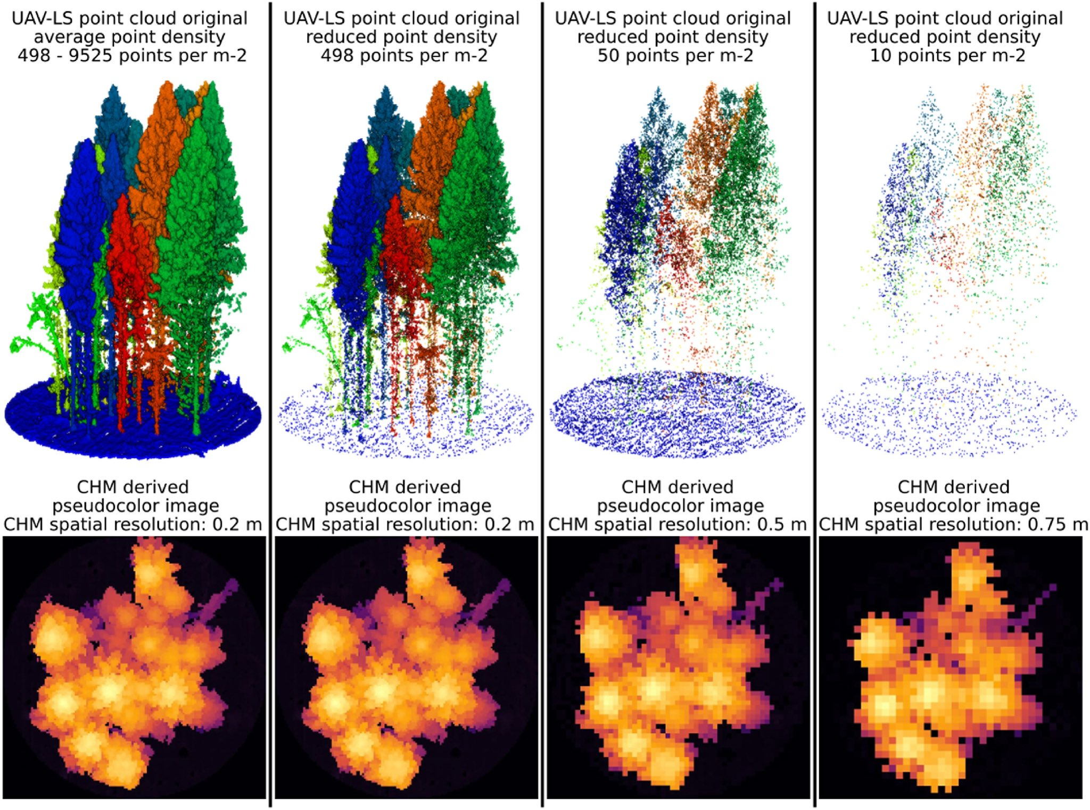
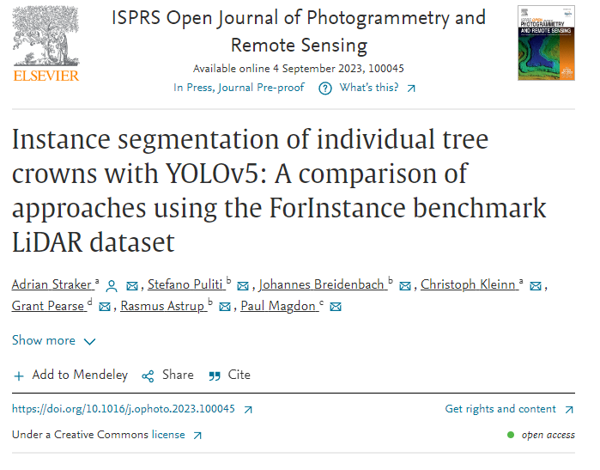
Also, Terrestrial Laser Scanning (TLS) with exceptional detail ! Note that LiDAR does not have ‘spatial resolution’ but ‘point density’
https://doi.org/10.1016/j.ophoto.2023.100045

Slide 26
Terminologies
TLS: Terrestrial Laser Scanning
ALS: Airborne Laser Scanning
Orbital or Spaceborne LiDAR
DLS: Drone Laser Scanning
LAS file
LAZ file (zipped)
Point density (pt per m2 or other area unit)

Slide 27
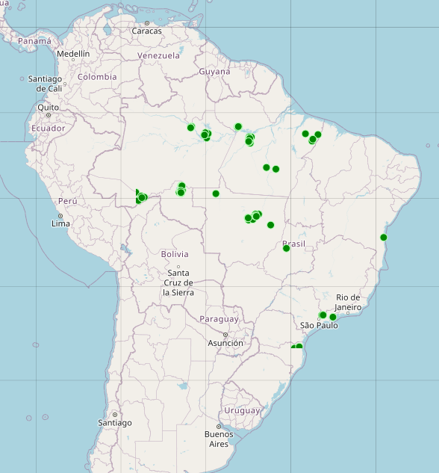
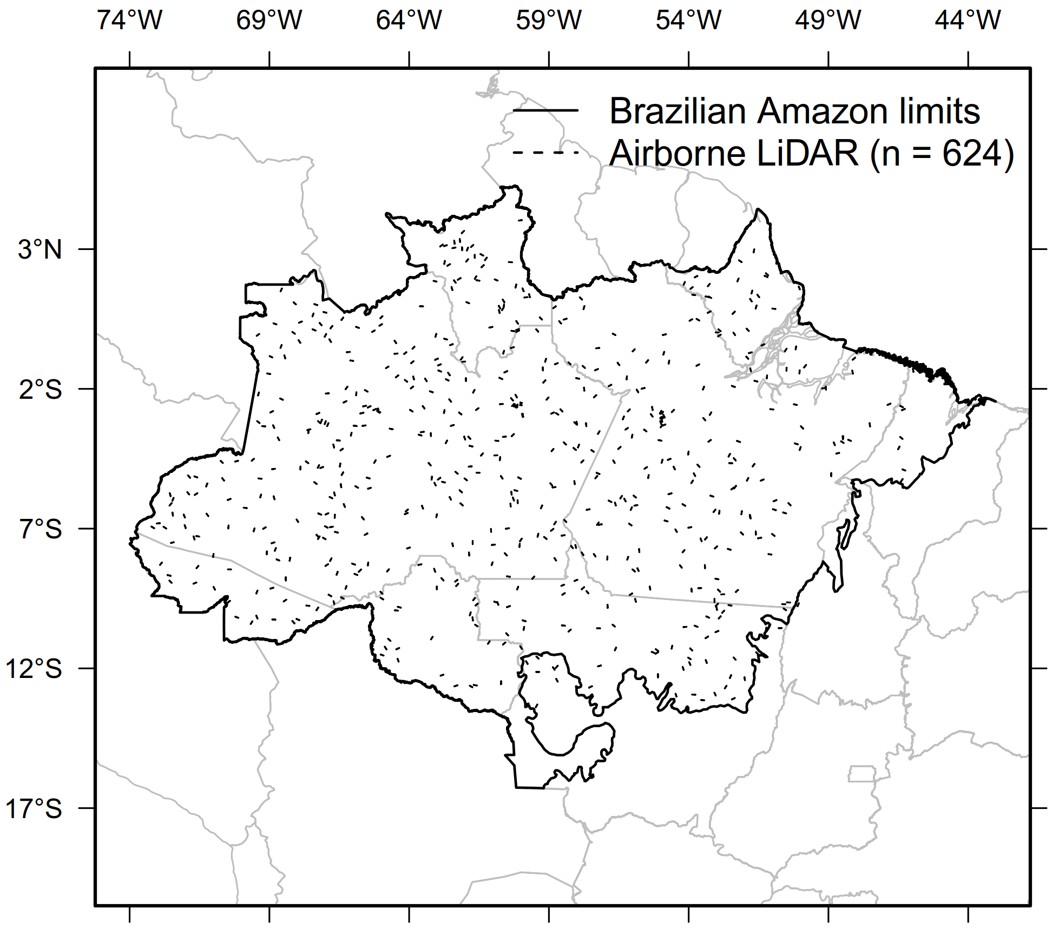


Where to obtain airborne LiDAR data in Brazil?
Paisagens sustentáveis https://www.paisagenslidar.cnptia.embrapa.br/webgis/
EBA Project INPE/CCST
Dr. Jean Ometto
900+ transects across Br. Amazon
Several sites with repeated LiDAR

Slide 28
What are the sources of orbital LiDAR?
IceSat (Ice, Cloud and land Elevation Satellite) GLAS (Geoscience Laser Altimeter System)
Data from 2003 to 2009
https://icesat.gsfc.nasa.gov/icesat/glas.php
IceSat-2
Data from 2018/2019 to today
https://icesat-2.gsfc.nasa.gov
GEDI (Global Ecosystem Dynamics Investigation) onboard of the ISS (International Space Station)
Data from 2019 to 2021(planned)
https://gedi.umd.edu/

Slide 29
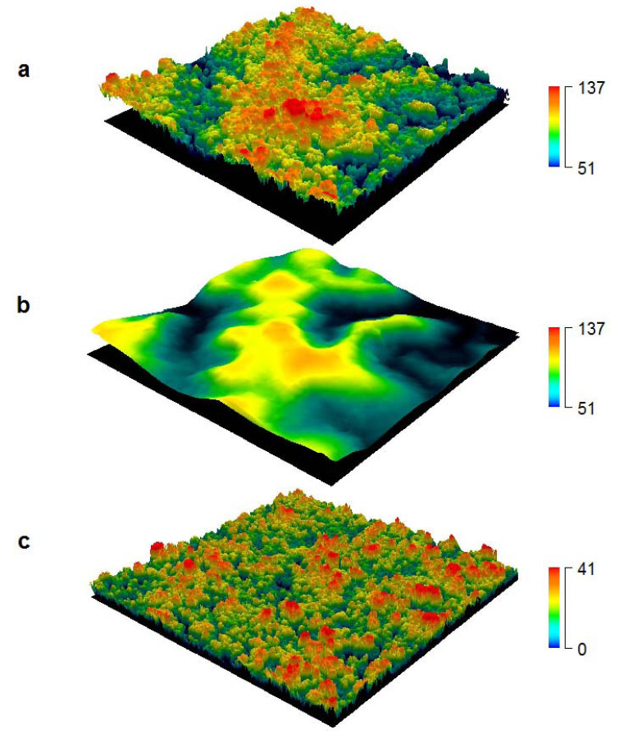
How to use the data? Metrics: Canopy Height Model (CHM)
Digital Surface Model (DSM)
Digital Terrain Model (DTM)
Canopy Height Model (CHM)
Source: K. Zhao et al. (2009); Kellner et al. (2019)
Notes:
Canopy and ground elevation from LiDAR remote sensing. Each image is an interpolated surface derived from LiDAR (a) The surface model contains estimates of canopy elevation relative to a reference ellipsoid (i.e., sea level). To calculate vegetation height above ground, laser pulses are classified as ‘vegetation’ or ‘ground’. Ground pulses were interpolated to produce a digital terrain model, which estimates ground elevation (b). Subtraction of the digital terrain model from the canopy surface produces a model of canopy height (c
http://esapubs.org/archive/ecol/E090/233/metadata.htm

Slide 30
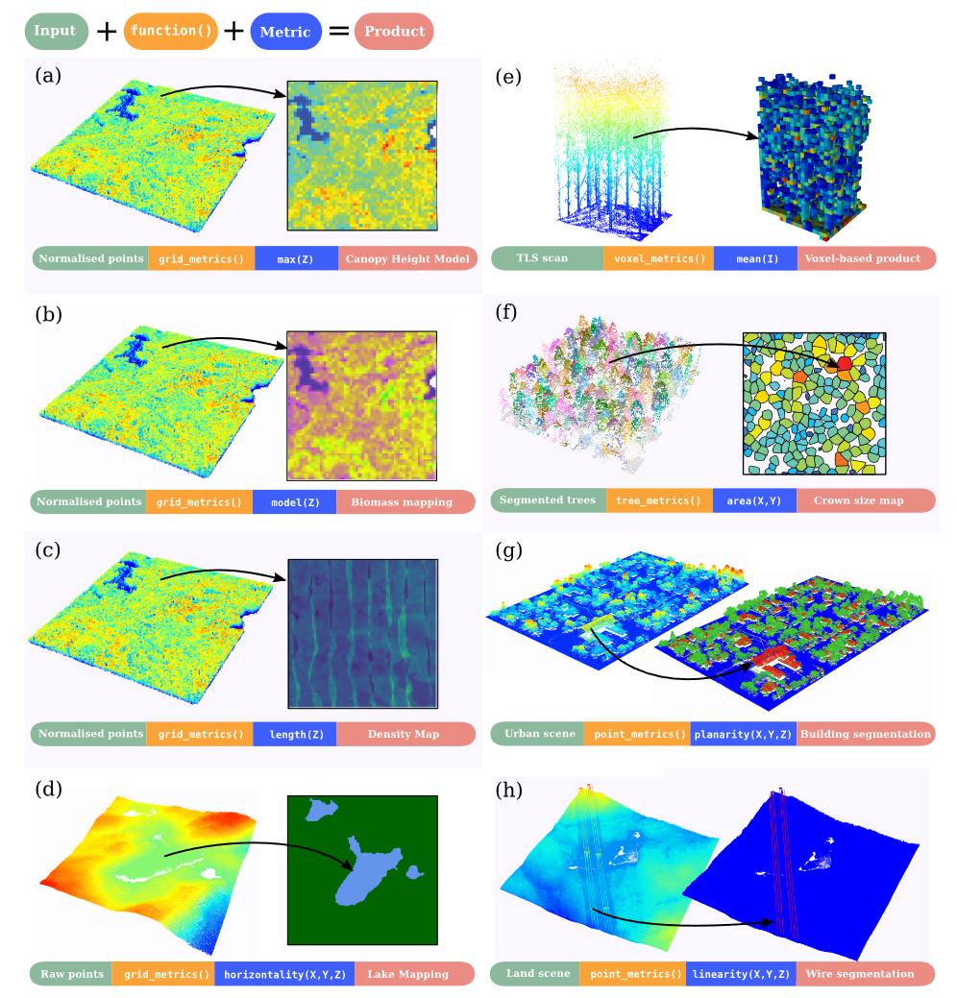
Lidar metrics and products in lidR
Source: lidR paper

Slide 31
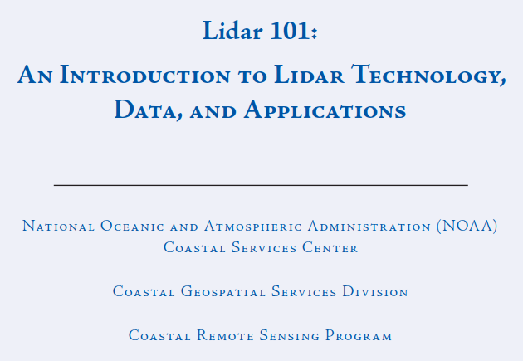
Resources
https://coast.noaa.gov/data/digitalcoast/pdf/lidar-101.pdf
NEON Lidar tutorials
https://www.neonscience.org/resources/learning-hub/tutorials
lidR handbook and tutorials
https://jean-romain.github.io/lidRbook/
lidR tutorial by T Goodbody 2023
https://tgoodbody.github.io/lidRtutorial/
Cool Videos with LiDAR explanation:
Space Lasers
https://svs.gsfc.nasa.gov/10835
A 3D Forest Map
https://svs.gsfc.nasa.gov/12398

Slide 32
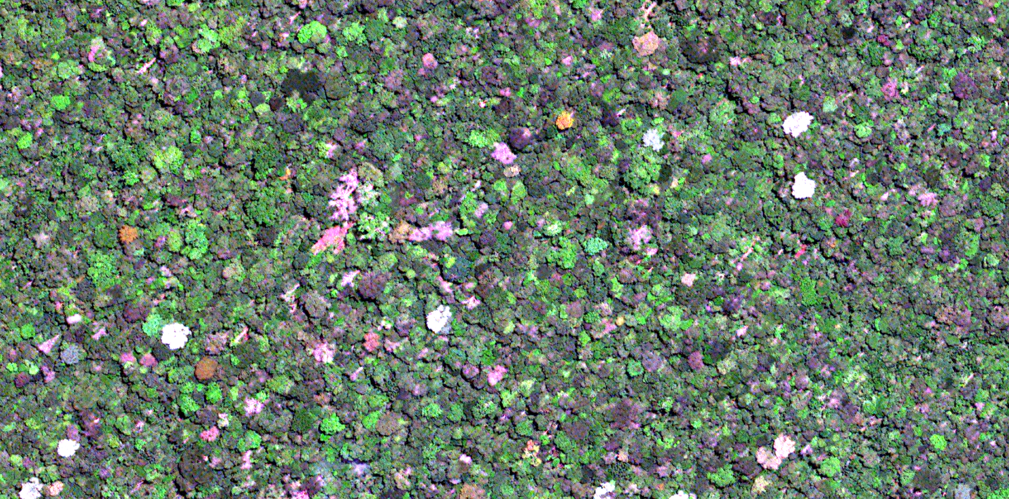

Summary
The LiDAR data is the highest accurate data for height estimate
Data availability from airborne to orbital is increasing every day
Let’s go for the codes
https://github.com/ricds/lidar_class
Ricardo Dal’Agnol da Silva
ricds@hotmail.com
@RicardoDalagnol

